Slide 1
Classfiers Implementation And Results Classifier 1-Gaussian Naive Bayes
Code:
import pandas as pd
import numpy
(trainDataGlobal, testDataGlobal, trainLabelsGlobal, testLabelsGlobal) = train_test_split(np.array(global_features),np.array(global_labels), test_size=test_size,random_state=seed)
clf_gauss=GaussianNB()
clf_gauss.fit(trainDataGlobal,trainLabelsGlobal)
NB_pr=clf_gauss.predict(testDataGlobal)
acc_NB = clf_gauss.score(testDataGlobal,testLabelsGlobal)
print('Accuracy',str(acc_NB*100)+"%")
cm=confusion_matrix(testLabelsGlobal,NB_pr)
print(cm)

Slide 2
Precision_NB=(cm[0][0])*100/(cm[0][0]+cm[1][0])
Sensitivity_NB=(cm[0][0])*100/(cm[0][0]+cm[0][1])
Specificity_NB=(cm[1][1])*100/(cm[1][1]+cm[1][0])
import seaborn as sm
sm.heatmap(cm,annot=True)
plt.xlabel('Predicted')
plt.ylabel('Actual')
print("[STATUS] splitted train and test data...")
print("Train data : {}".format(trainDataGlobal.shape))
print("Test data : {}".format(testDataGlobal.shape))
print("Precision=TP/TP+FP:",(cm[0][0])*100/(cm[0][0]+cm[1][0]),'%')
print("Sensitivity=TP/TP+FN:",(cm[0][0])*100/(cm[0][0]+cm[0][1]),'%')
print("Specificity=TN/TN+FP:",(cm[1][1])*100/(cm[1][1]+cm[1][0]),'%')
f_NB=2*(Precision_NB*Sensitivity_NB)/(Precision_NB+Sensitivity_NB)
print("F1-Score:",f_NB,'%')

Slide 3
Algorithm Explanation
1) From Training set find the prior probability P(diseased)=(diseased)/(diseased + healthy) P (healthy)=(healthy)/(diseased + healthy).
2) Find the mean, variance for the all the 550 feature given the target is plant is healthy or diseased separately from the test data, i.e. if plant is healthy calculate the mean and variance of the given feature.
3) From the test data, for all the leaves we now predict whether that belongs to which class i.e healthy or diseased.

Slide 4
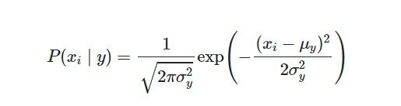

Using below mentioned formulas:
$$\begin{aligned}P(y∣x_{1},…,x_{n})∝P(y)\prod_{i=1}^{n}{}P(x_{i}∣y) \\ ⇓ \\ \overset{^}{y}=arg⁡\max_{y}P(y)\prod_{i=1}^{n}{}P(x_{i}∣y),\end{aligned}$$
Where:
P(y)=prior probability
μ$y$=mean of feature x given class Y or in this case diseased plant or healthy one (from training data)
X_{i=} i^{th} feature value for the test data
σ_{y}² =variance of feature x given class Y or in this case diseased plant or healthy one (from training data)

Slide 5
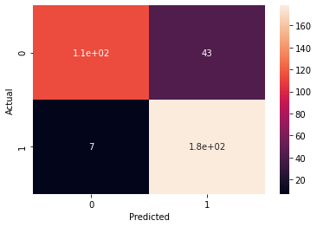
Output Using SLIC Segmentation Technique
Accuracy 85.38011695906432%
[[114 43] [ 7 178]]
[STATUS] splitted train and test data... Train data : (1367, 549) Test data : (342, 549)
Precision=TP/TP+FP: 94.21487603305785 %
Sensitivity=TP/TP+FN: 72.61146496815287 %
Specificity=TN/TN+FP: 96.21621621621621 %
F1-Score: 82.01438848920864 %

Slide 6
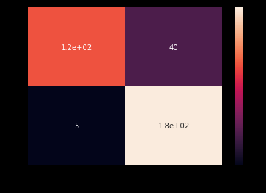
Output Using Masking Segmentation Technique
Accuracy 86.8421052631579%
[[117 40] [ 5 180]]
[STATUS] splitted train and test data... Train data : (1367, 549) Test data : (342, 549)
Precision=TP/TP+FP: 95.90163934426229 %
Sensitivity=TP/TP+FN: 74.52229299363057 %
Specificity=TN/TN+FP: 97.29729729729729 %
F1-Score: 83.87096774193547 %

Slide 7
Classifier 2-Support vector Machine
Code:
import pandas as pd
import numpy
from sklearn.svm import SVC
clf=SVC(random_state=9)
clf.fit(trainDataGlobal, trainLabelsGlobal)
pred=clf.predict(testDataGlobal)
from sklearn.metrics import accuracy_score,confusion_matrix
acc_svm = accuracy_score(pred, testLabelsGlobal)
print('Accuracy:',str(acc_svm*100)+"%")
cm=confusion_matrix(testLabelsGlobal,pred)

Slide 8
print(cm)
Precision_svm=(cm[0][0])*100/(cm[0][0]+cm[1][0])
Sensitivity_svm=(cm[0][0])*100/(cm[0][0]+cm[0][1])
Specificity_svm=(cm[1][1])*100/(cm[1][1]+cm[1][0])
import seaborn as sm
sm.heatmap(cm,annot=True)
plt.xlabel('Predicted')
plt.ylabel('Actual')
print("Precision=TP/TP+FP:",(cm[0][0])*100/(cm[0][0]+cm[1][0]),'%')
print("Sensitivity=TP/TP+FN:",(cm[0][0])*100/(cm[0][0]+cm[0][1]),'%')
print("Specificity=TN/TN+FP:",(cm[1][1])*100/(cm[1][1]+cm[1][0]),'%')
f_svm=2*(Precision_svm*Sensitivity_svm)/(Precision_svm+Sensitivity_svm)
print("F1-Score:",f_svm,'%')
plt.show()

Slide 9
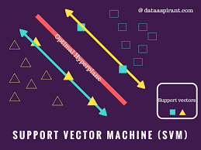
Algorithm Explained And Mathematics Behind it!
This is a supervised machine learning algorithm which can be used for both classification and regression type of problems.
We are using this algorithm as single class classification algorithm.
It works well with larger amount of features as well.

Slide 10
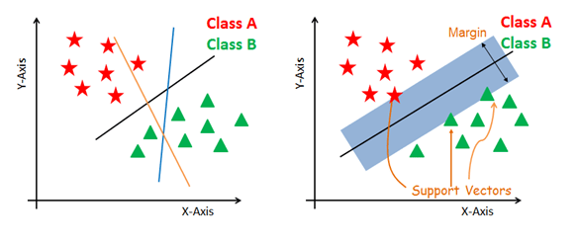
Suppose we have 2 feature and want to classify in 2 broad category shown in the figures.
The objective to SVM is to plot a hyperplane that divides the labelled data into 2 half's.
We also need to plot 2 planes parallel to hyperplane which passes through the nearest point from the hyperplane for both the category. These points are called support vectors.
We can have multiple such hyperplanes but there is one more constraint i.e we need to maximize the margin distance.
Margin distance is calculated as distance between 2 margin lines.

Slide 11
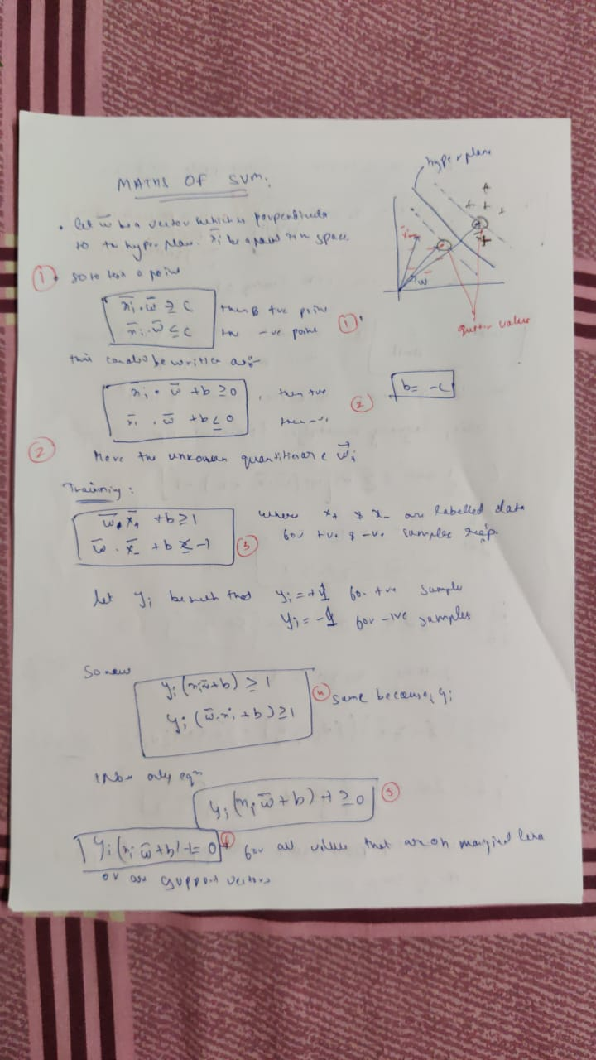
Maths of SVM

Slide 12
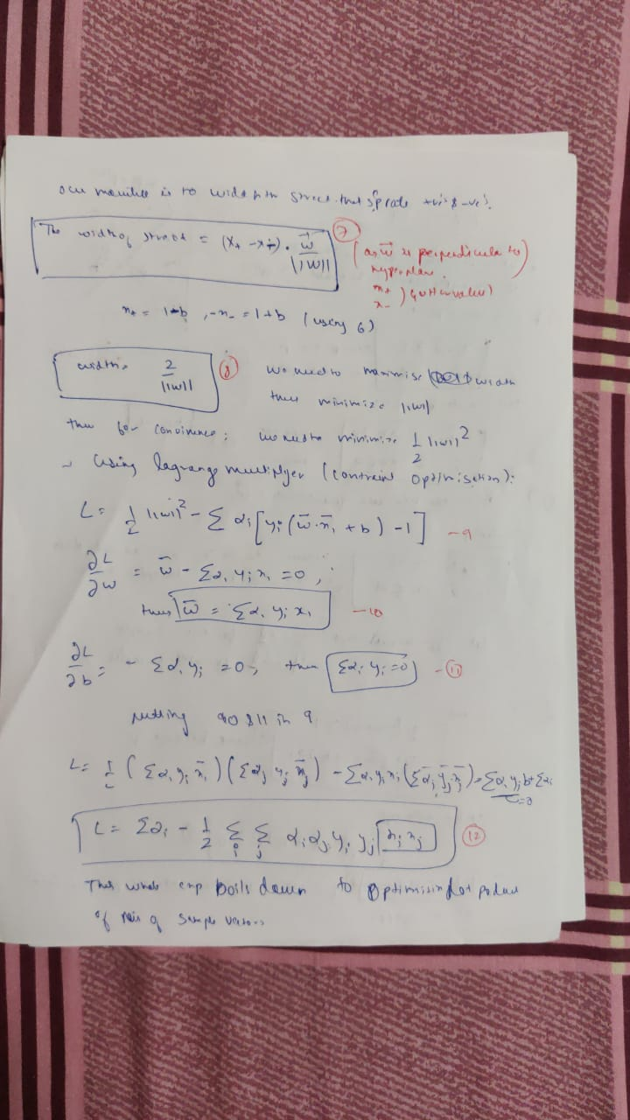

Slide 13


Slide 14
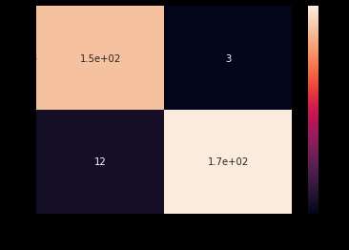
Output Using SLIC Segmentation Technique
Accuracy: 95.6140350877193%
[[154 3] [ 12 173]]
Precision=TP/TP+FP: 92.7710843373494 %
Sensitivity=TP/TP+FN: 98.08917197452229 %
Specificity=TN/TN+FP: 93.51351351351352 %
F1-Score: 95.35603715170278 %

Slide 15
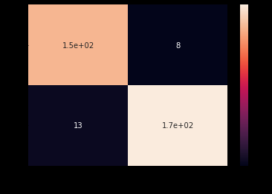
Output Using Masking Segmentation Technique
Accuracy: 93.85964912280701%
[[149 8] [ 13 172]]
Precision=TP/TP+FP: 91.9753086419753 %
Sensitivity=TP/TP+FN: 94.90445859872611 %
Specificity=TN/TN+FP: 92.97297297297297 %
F1-Score: 93.41692789968651 %

Slide 16
Classifier 3-Random Forest
from sklearn.ensemble import RandomForestClassifier
from sklearn.metrics import accuracy_score
import pandas as pd
import numpy
clf=RandomForestClassifier(n_estimators=1000,criterion='entropy',random_state=0)
clf.fit(trainDataGlobal,trainLabelsGlobal)
pred=clf.predict(testDataGlobal)
acc_rf=accuracy_score(pred,testLabelsGlobal)
print("Accuracy:",str(acc_rf*100)+"%");
cm=confusion_matrix(testLabelsGlobal,pred)
print(cm)
Precision_rf=(cm[0][0])*100/(cm[0][0]+cm[1][0])
Sensitivity_rf=(cm[0][0])*100/(cm[0][0]+cm[0][1])
Specificity_rf=(cm[1][1])*100/(cm[1][1]+cm[1][0])

Slide 17
import seaborn as sm
sm.heatmap(cm,annot=True)
plt.xlabel('Predicted')
plt.ylabel('Actual')
print("Precision=TP/TP+FP:",(cm[0][0])*100/(cm[0][0]+cm[1][0]),'%')
print("Sensitivity=TP/TP+FN:",(cm[0][0])*100/(cm[0][0]+cm[0][1]),'%)
print("Specificity=TN/TN+FP:",(cm[1][1])*100/(cm[1][1]+cm[1][0]),')
f_rf=2*(Precision_rf*Sensitivity_rf)/(Precision_rf+Sensitivity_rf)
print("F1-Score:",f_rf,'%')
importances=clf.feature_importances_
for x in range (0,len(importances)):
print("Feature {}:{}".format(x,importances[x]))
plt.subplots(figsize =(16,9))
plt.bar(np.arange(0,549),importances)
plt.show()

Slide 18
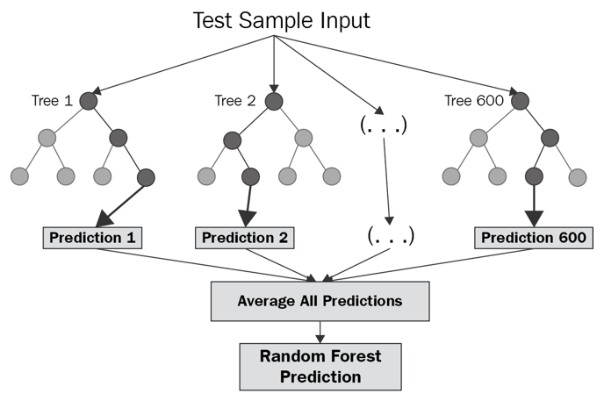
Algorithm Explanation
This is a classification algorithm.
The subroutine of this algorithm is decision tree.
When the data set is very large the height of single decision tree will be very large which would result is performance of algorithm.
Thus we split the data set and make different decision trees and then take an average and return the result.
While building subsets of data for trees, the word “random” comes into the picture. A subset of data is made by randomly selecting x number of features (columns) and y number of examples (rows) from the original dataset of n features and m examples.

Slide 19

But how come we decided that we should first split the data based on a particular feature and not on any other feature?
The reason is that this split was reducing the entropy by the maximum amount and gain is maximum.
Information Gain The information gain is the amount by which the Entropy of the system reduces due to the split that we have done. We have created the tree using observations.

Slide 20
Entropy is a measure of the randomness of a system. The entropy of sample space S is the expected number of bits needed to encode the class of a randomly drawn member of S. Lets suppose we have 14 rows in our data so 14 members.
Entropy E(S)= -∑p(x)*log2(p(x))
The entropy of the system is calculated by the above formula where p(x) is the probability of getting class x from those 14 members(assuming). We have two classes here one is Yes and the Other is No in target column.
E(S)= -[p(Yes)*log(p(Yes))+ p(No)*log(p(No))];
where yes means diseased otherwise healthy

Slide 21
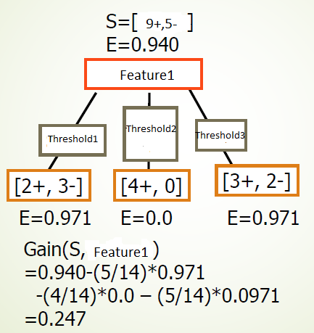

Slide 22

Conclusive Steps for Random Forest using previously mentioned formulas and concepts.

Slide 23
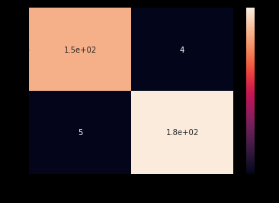
Output Using SLIC Segmentation Technique
Accuracy: 97.36842105263158%
[[153 4] [ 5 180]]
Precision=TP/TP+FP: 96.83544303797468 %
Sensitivity=TP/TP+FN: 97.45222929936305 %
Specificity=TN/TN+FP: 97.29729729729729 %
F1-Score: 97.14285714285715 %

Slide 24
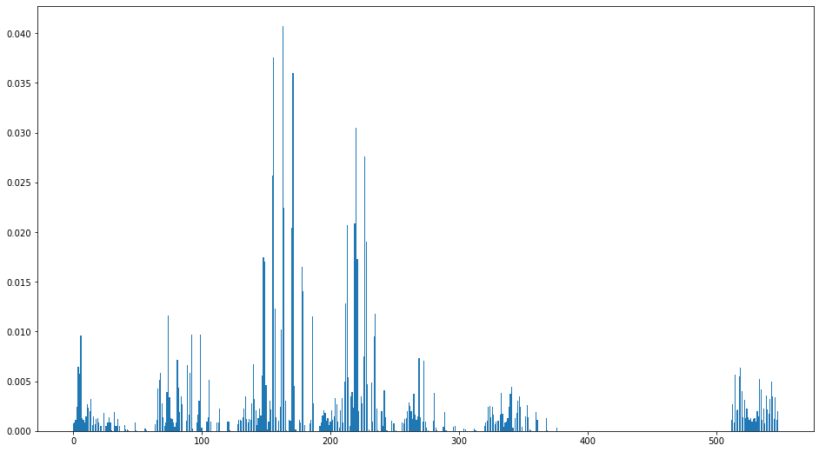
Contribution of Each feature in Classification

Slide 25
Output Using Masking Segmentation Technique
Accuracy: 97.36842105263158%
[[153 4] [ 5 180]]
Precision=TP/TP+FP: 96.83544303797468
% Sensitivity=TP/TP+FN: 97.45222929936305%
Specificity=TN/TN+FP: 97.29729729729729 %
F1-Score: 97.14285714285715 %

Slide 26
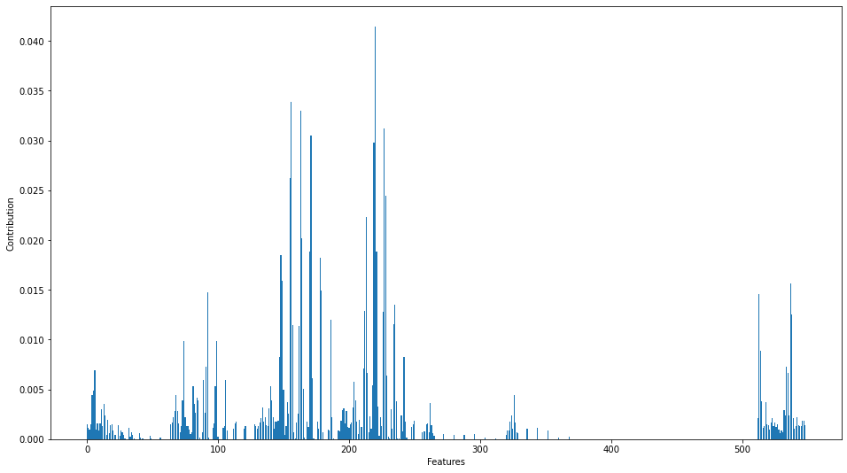
Contribution of Each feature in Classification

Slide 27
Performance Analysis and Comparison of Algroithms.
Code:
import matplotlib.pyplot as plt
graph_data = [[acc_NB*100,acc_svm*100,acc_rf*100],
[Precision_NB,Precision_svm,Precision_rf],
[Sensitivity_NB,Sensitivity_svm,Sensitivity_rf],
[Specificity_NB,Specificity_svm,Specificity_rf],[f_NB,f_svm,f_rf]]
X = np.arange(3)
fig,ax = plt.subplots()
fig.set_figheight(10)
fig.set_figwidth(20)
rects1=ax.bar(X-0.250 , graph_data[0], color = 'b', width = 0.125,label='Accuracy')
rects2=ax.bar(X-.125, graph_data[1], color = 'g', width = 0.125,label='Precision')
rects3=ax.bar(X , graph_data[2], color = 'r', width = 0.125,label='Sensitivity')

Slide 28
rects4=ax.bar(X + 0.125, graph_data[3], color = 'y', width = 0.125,label='Specificity')
rects5=ax.bar(X + 0.250, graph_data[4], color = 'orange', width = 0.125,label='F1-score')
ax.set_xticks([0,1,2])
ax.set_xticklabels(["NB","SVM","RF"])
ax.legend()
def autolabel(rects):
for rect in rects:
height = rect.get_height()
ax.text(rect.get_x() + rect.get_width()/2., 1*height,
'%d' % int(height),
ha='center', va='bottom')
autolabel(rects1)
autolabel(rects2)
autolabel(rects3)
autolabel(rects4)
autolabel(rects5)
plt.show()
import pandas as pd
p_data = [["Gaussian Naive Bayes",acc_NB*100,Precision_NB,Sensitivity_NB,Specificity_NB,f_NB],
["Support Vector Machine",acc_svm*100,Precision_svm,Sensitivity_svm,Specificity_svm,f_svm],
["Random Forest",acc_rf*100,Precision_rf,Sensitivity_rf,Specificity_rf,f_rf]
]
perf_data=pd.DataFrame(p_data,columns=["Algo used","Accuracy(%)","Precision(%)","Sensitivity(%)","Specificity(%)","F1_score(%)"])
print(perf_data)

Slide 29
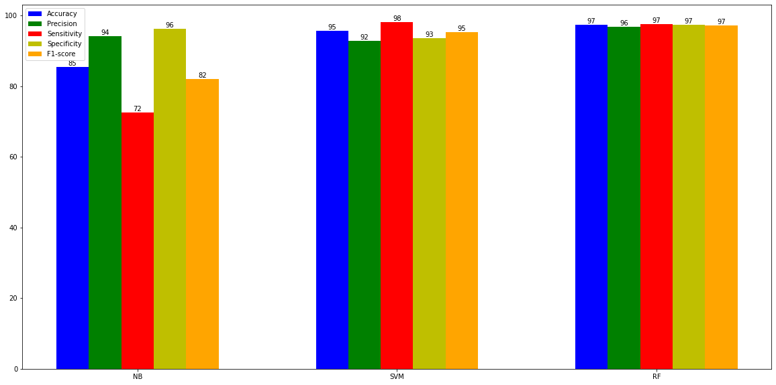
Bar Graph Comaparison using SLIC segmentation

Slide 30
Comparison table
Algo used | Accuracy(%) | Precision(%) | Sensitivity(%) | Specificity(%) | F1_score(%)
Gaussian Naive Bayes | 85.380117 | 94.214876 | 72.611465 | 96.216216 | 82.014388
Support Vector Machine | 95.614035 | 92.771084 | 98.089172 | 93.513514 | 95.356037
Random Forest | 97.368421 | 96.835443 | 97.452229 | 97.297297 | 97.142857

Slide 31
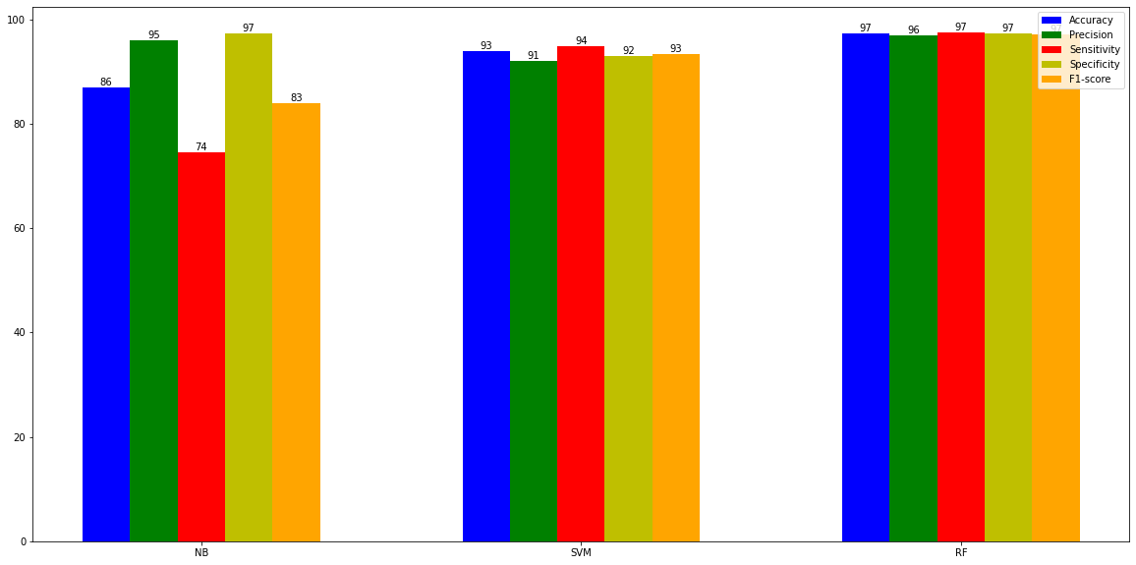
Bar Graph Comaparison using Masking segmentation

Slide 32
Comparison table
Algo used | Accuracy(%) | Precision(%) | Sensitivity(%) | Specificity(%) | F1_score(%)
Gaussian Naive Bayes | 86.842105 | 95.901639 | 74.522293 | 97.297297 | 83.870968
Support Vector Machine | 93.859649 | 91.975309 | 94.904459 | 92.972973 | 93.416928
Random Forest | 97.368421 | 96.835443 | 97.452229 | 97.297297 | 97.142857

Slide 33
Algorithm | Type | Accuracy | Interpretabilty | Data Size Handling | Resistant to Multicollinearity | Susceptibe To Outliers | Assumptions | Training Phase time | Test Phase Timings
Support vector Machine | Non Parametric | High | Medium | Large | No | Yes | Flexible | Medium | Low
Naïve Bayes | Probabilistic | Medium | Medium | Large | Yes | Yes | Flexible | Medium | Low
Random Forest | Rule Based | High | Low | Large | Yes | No | Flexible | High | Medium

Slide 34
Conclusions from comparison tables and graphs
1)Gaussian Naïve Bayes performs the worst among the three:
As It is a Parametric model ,where generally we have a mathematical equation involved which works under specific circumstances in order to function properly. In other words, there is set of strict assumptions that should be fulfilled which allow the algorithm that the data belongs to particular family of distributions.
Therefore its accuracy is less compared to others as its not flexible and assumes parameters are independent which might not be the case.
Another way to say this is that it usually isn’t the case that P(Z| X, Y) = P(Z|X) * P(Z|Y), which naive Bayes classification assumes.

Slide 35
2) SVM works better than Naïve Bayes
As it chooses the most optimal model of all the models its generate ie.hyperplane with the maximum margin.
Kernel can be used to increase the dimensionality of the feature set,therefore making separation of data into classes easier than in the lower dimensionality.
But works less efficiently than random forest.
4)Random forest works best
as at each level of splitting the node it consider the best feature to separate into classes in the form of maximum information gain.
Since it’s a rule based algorithm ,so descison making is better than other algorithms.

